Slide 1



ROBOTIC PROCESS AUTOMATION
AUTOMATE REPETITIVE WORK &
FREE UP YOUR BUSINESS

Slide 2
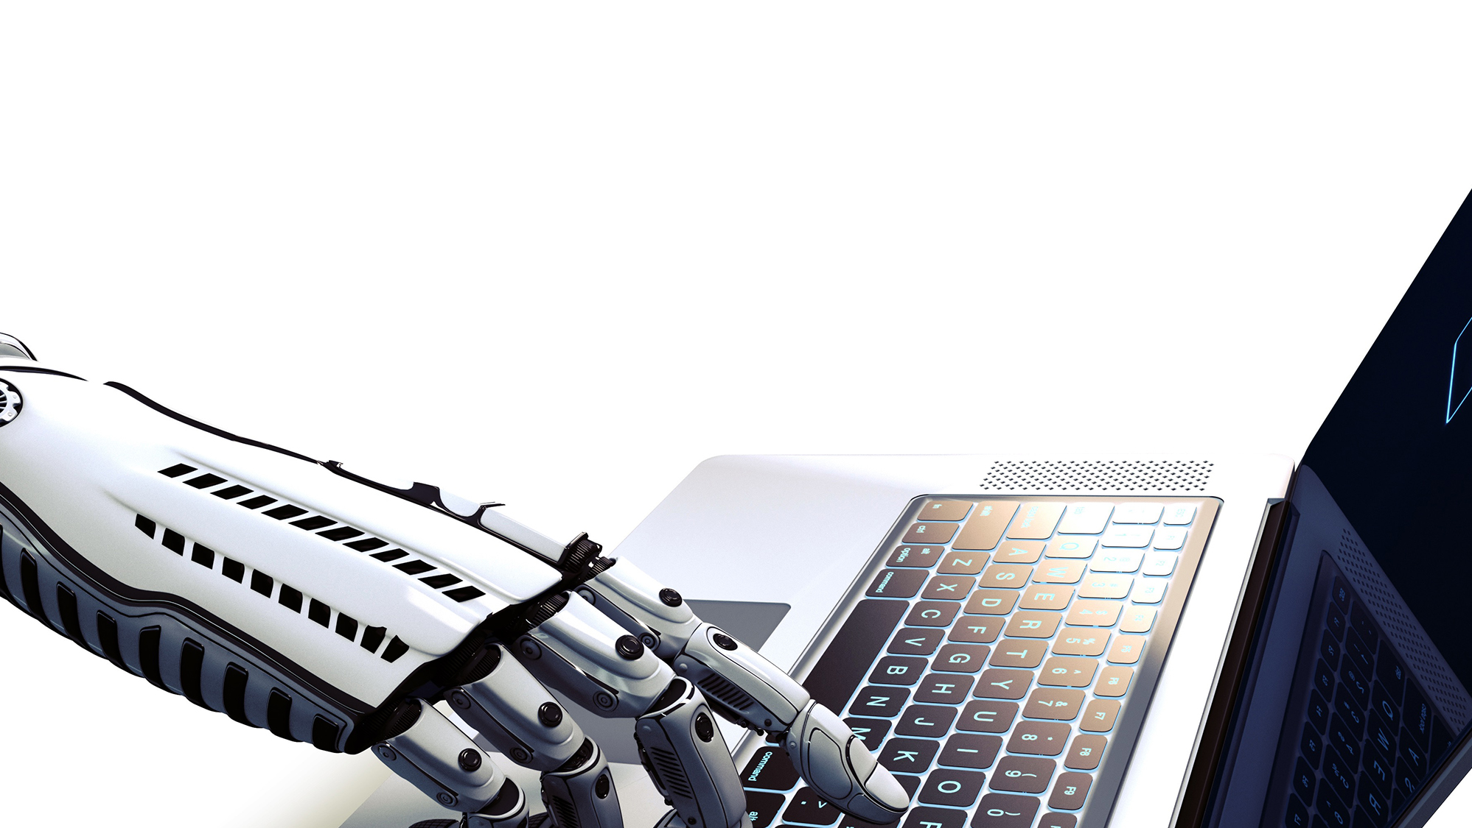
DIGITAL BUSINESS
AUTOMATION
What is RPA?
Robotic Process Automation is the innovative use of software to perform repetitive rules-based knowledge work across an organization as a substitute for, or aide to, human workers.
“Virtual Workers” replicate the specific actions a human would take while working with IT systems, the decisions they make, and the logical processes they follow, while interacting between different systems and applications.

Slide 3


45% of all work
activities can be automated
$2 trillion dollars
could be saved in workforce spending
6-9 Months
on average ROI for an RPA project
HOW IS RPA AFFECTING
THE WAY WE WORK?
94% of CEOs
that have incorporated RPA believe
that it has increased the productivity
By 2025
25% of jobs will be robotized

Slide 4



RPA
BUSINESS BENEFITS
Government and regulatory compliance
Virtual workforce 24x7x365
Productivity increase
Reduction of human errors
Flexibility
Cost reduction
Scalability
RAPID IMPLEMENTATION AND ROI
REDUCES THE NUMBER OF FTES IN A PROCESS

Slide 5


How RPA Works?
No significant change to the current IT infrastructure
No changes to existing interfaces
No need for a massive upfront investment
Reduces swivel chair integration
Robotic Process Automation is expected to save companies 50-70% on labor costs by making intelligent use of resources, near-zero error rates, improved compliance and reduced process cycle time, all of these through the implementation of machine learning and AI to develop/enhance procedures.
FOCUS ON ONLY JOBS HUMANS CAN DO
STRATEGY, CREATIVITY AND
CONNECTING WITH PEOPLE

Slide 6

RPA TYPICAL BUSINESS PROCESSES
RPA can learn from people, eventually taking over the processes that humans once completed, at a much faster pace.
Repetitive tasks Carried out 50-60
times a day
Process List
and Storage
Data Entry
Periodic reporting
and data analysis
Mass Email Generation
Archiving and extracting
Data Conversion
Conversion of data
format and graphics
ERP Transactions
ERP and other back
office transactions

Slide 7



VALUE PROPOSAL
Why RPAide?
We have packaged IBM Automation Anywhere to deliver a start point for your own RPA business strategy.
Start with a process, Start Saving

Slide 8

PRACTICAL CASE
This example will demonstrate the requisition and purchase process of materials, in RPA this is a process from end to end (requisition to payment) where a sequence of activities are executed by multiple users interacting with multiple systems (mail client, Excel, SAP).
In this case the bots are integrated in almost all stages of the process and through multiple functions.
PROCESS STEPS
Requester: Create in Excel and send the request.
Buyer: Receive and consolidate order requests organized by vendor, create and release purchase order in SAP.
Vendor: Send XML and invoice PDF.
AP Analyst: Extract information from the invoice and register it in SAP.
PROBLEMATIC
The execution of manual tasks cause the process to be slow, subject to deviations, causing bottlenecks in which it is necessary to invest several hours. The extraction of data from different applications or platforms becomes an extensive task in which it is necessary to invest more than one resource in the execution of a simple process.
AREAS INVOLVED
Purchasing, Warehouse and Accounts Payables.
USERS INVOLVED
Requester, Buyer, Vendor and AP analyst.

Slide 9







MANUAL PROCESS VS PROCESS IN RPAIDE
Requester
Create request
Is it all the information?
All purchase orders created?
?
Yes
?
Yes
Open mail
Download
Consolidate
Complete Purchase
Information
Assign vendor to Each material
Login SAP
Generate Purchase
Order by vendor
Send mail to
requester
Buyer
No
No
Review and release
purchase order in SAP
Warehouse
Material reception
Vendor
Send XML and PDF by mail
End
AP Analyst
Download files
Extract invoice
data
Login
SAP
Generate accounts
payable document

Slide 10

CONTACT INFORMATION
630 Davis Drive, Suite 210 Morrisville, NC 27560 USA
+1-919-484-1690
marketing@emergys.com

